Slide 1
TDL Forum
June 26, 2013
DEBRA HANKEN KURTZ, Executive Director
KRISTI PARK, Program Coordinator

Slide 2
Agenda
- Welcome and introductions
- Observations: TDL’s Strengths and Challenges (Debra)
- Looking Forward (Debra)
- Groups and Committees Updates (Kristi)
- Upcoming travel (Kristi)
- Q&A

Slide 3


Strengths
Notes:
In the weeks since I’ve been at TDL I’ve learned much about the strengths most notably the talented and dedicated staff. I met with each of them at existing regular one-on-one meetings with Ryan. They shared concerns about infrastructure and the current project load. They expressed a shared vision for how to manage and improve infrastructure and a desire to experiment and push the technical boundaries of TDL. The group is planning work to ensure the continued success of existing services such as upgrades to Vireo; expanding DSpace service; and growing the annual Texas Conference on Digital Libraries.
Our greatest asset is you, our members. The work we can accomplish together offers us all the most promising opportunities. This will include investigating and implementing new solutions for open access to streaming media; participation in national and global communities; more strategic planning to ensure growth and sustainability of core services and more thoughtful and better coordinated experimentation with newer technologies.

Slide 4
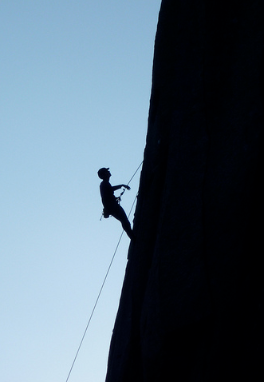

Challenges
Notes:
Sustainability
We have about a 48 month period of relative solvency under the current membership structure.
Technical Debt
Over the last couple of weeks, I have the opportunity to talk with TDL staff to get a clearer picture of what needs immediate attention. Our greatest priority over the summer will be to address our technical debt. These are projects that have gone fallow or were never initiated, as well as opportunities we may have missed due to efforts to keep current services running well. Technical debt quickly translates into fiscal debt when services or their components are made unnecessarily redundant and/or it’s not possible to recognize and experiment with newer services and tools that might yield a greater return on your investment. (Maverick model worked well in beginning now eager to self-organize.)
Organization and Staffing
We are eager to organize ourselves and impose more structure so that we can manage our work more efficiently and communicate our productivity more effectively. We have a couple of staff vacancies and are assessing those needs so we can recruit the best people to help move us forward.
Communications
We need to improve the graphic and technical brand so we communicate under a consistent look and feel.. We also need to promote greater transparency to our members about our work with you, successful projects and the not so successful endeavors.

Slide 5
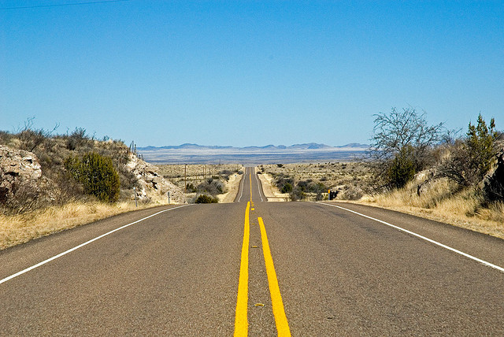
Looking Forward
Notes:
Strategic Planning (to build on higher level strategic vision of the governing board. See website.)
We’ve recently embarked on two tracks of strategic planning. One centered on outreach which will include polishing our cosmetic look on our website and other interfaces; beefing up our social media strategy; and improving our print publications. We are also planning new outreach activities to governing and member boards and are planning new events and event marketing including more OA week events. We want to work with you to identify areas for training. (Amazon example) Advanced DSpace training after 3.0 upgrade. We will lead strategic initiatives as defined by the governing board. (Examples?) We also will document and communicate a membership drive roadmap.
The second track of the strategic planning will address the Technical Debt. Using the mission and guiding principles we develop in our outreach planning, we will prioritize work needed to streamline and document our technical work. Outcomes should include improved service and greater transparency to our members.

Slide 6
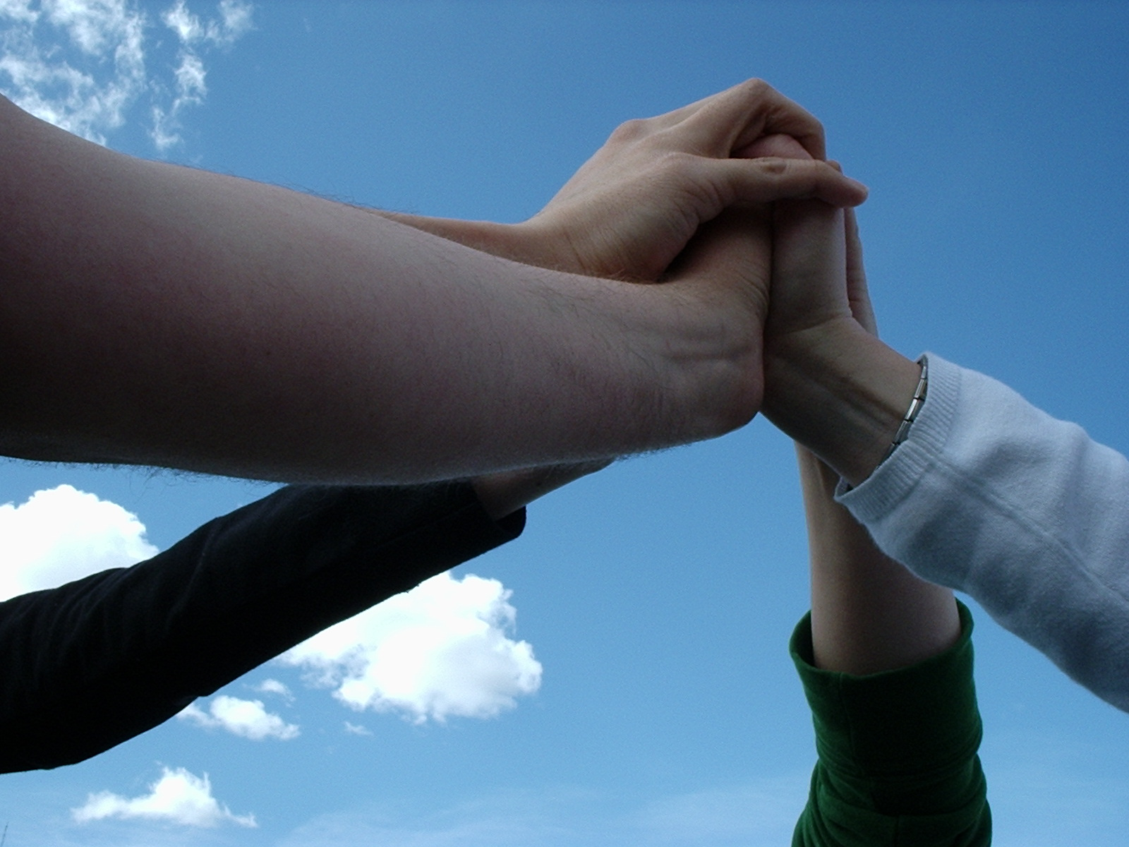

Groups & Committees
  TDL Conference Committee
    Chair: Billie Peterson-Lugo, Baylor
Vireo Users Group
  Chairs: Laura Hammons (Texas A&M) and Stephanie Larrison (Texas State)
TDL Awards Committee
  Chair: Michele Reilly, University of Houston
TDL Metadata Community
  Chair: Sarah Potvin, Texas A&M
TDL DSpace Users Group
  Chair: Mira Greene, UTMB Galveston
TDL DPN Discussion Group
  Chair: Ladd Hanson (UT Austin
For more info:
Look for “Groups” in the Members section of TDL.org.
Notes:
TDL Conference Committee
The TDL Conference Committee is appointed by the Governing Board and is responsible for planning the annual Texas Conference on Digital Libraries.
The committee for TCDL 2014 consists of:
Chair: Billie Peterson-Lugo (Baylor University)
Vice-Chair: Elizabeth Gushee (Harry Ransom Humanities Research Center, UT Austin)
Jim Brewer (Texas Tech)
Cameron Kainerstorfer (UT Southwestern Medical Center)
Nerissa Lindsay (Texas A&M International University)
Rachel Vacek (University of Houston)
Kristi Park (Texas Digital Library)
Vireo Users Group
The Vireo Users Group gathers and prioritizes constituent needs to guide TDL on future development of the Vireo ETD submission and management software. It also provides avenues for the exchange of information about Vireo use and development.
Co-Chairs: Laura Hammons (Texas A&M University) and Stephanie Larrison (Texas State University)
New URL for the VUG website: http://vireoetd.org/
TDL Metadata Community
The TDL Metadata Community re-formed in the summer of 2013 to provide a forum for mutual support and discussion around metadata issues.
Chair: Sarah Potvin, Texas A&M University
TDL Awards Committee
The TDL Awards Committee is appointed by the Governing Board to recognize outstanding work in digital libraries at academic institutions throughout Texas.
Chair: Michele Reilly (University of Houston)
Board sponsor: Douglas Ferrier (Texas A&M International University)
Shelley Barba (Texas Tech University)
Cindy Boeke (Southern Methodist University)
Susan Elkins (Angelo State University)
Kate Krause (Houston Academy of Medicine – Texas Medical Center Library)
Stephanie Larrison (Texas State University)
Darryl Stuhr (Baylor University)
Kristi Park (Texas Digital Library)
TD DPN Group
Ladd Hanson: Chair
Mike Bolton (TAMU)
Heidi Winkler (Texas Tech)
Dan Galewsky (TDL)

Slide 7
Upcoming Travel
Look for TDL at these conferences and meetings:
Open Repositories 2013 | July 8-12 | University of Prince Edward Island
Cross Timbers Library Collaborative 2013 Conference | August 16 | Denton, TX
US ETD Association Conference | July 24-26 | Claremont, CA
Texas Council of Academic Libraries Meeting | September 10-11 | Austin, TX
DLF Forum| November 4-6 | Austin, TX

Slide 8

Questions & Discussion

