Slide 1
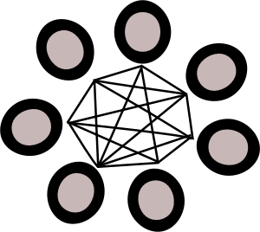
TDL Forum
WEDNESDAY, March 18, 2015
Kristi Park
Interim Director/Marketing Manager
Ryan Steans
Director of Operations
This work is licensed under a Creative Commons Attribution 4.0 International License.

Slide 2
Agenda
Reports: Meetings and Conferences
Operational update
Vireo 3 open-source release
Vireo 3 upgrades
Hiring
Training and upcoming events
Other announcements

Slide 3
Reports
Meetings and conferences

Slide 4
TxETDA/ USETDA Region 3 2015 Joint Conference
February 26-27, 2015
Waco, Texas
TDL ETD Metadata Working Group: Colleen Lyon, Kristi Park, Monica Rivero, Kara Long, Santi Thompson, Sarah Potvin
Conference Program: http://bit.ly/1Fxtb2M
Notes:
Ryan Steans, Gad Krumholz, and I attended the Texas ETD Association/USETDA Region 3 conference hosted by Baylor University Libraries late last month, along with quite a few of you on the phone.
This is always a wonderful event for those in both the libraries and the graduate schools who work with electronic theses and dissertations, and we were very pleased to be a part of the program in a number of ways this year. The conference has grown to include not just ETD professionals from Texas but also from the USETDA Region 3, which includes Oklahoma and Louisiana and several other states.
The group pictured here – the members of the TDL ETD Metadata Working Group – presented a preliminary report on their work to refresh the TDL’s metadata standard for ETDs. The group will also present an update at TCDL in the form of a poster.
Stephanie Larrison (VUG co-chair) and I also presented on the latest round of Vireo development, and Ryan led a workshop on day 2 of the conference demonstrating new features in the latest release of Vireo (Vireo 3).

Slide 5
15th International PASIG Meeting
March 11-13, 2015 | San Diego
What’s new with DuraCloud
Digital Preservation Network
Gad Krumholz, TDL
Notes:
Gad Krumholz, senior software engineer here at TDL, last week attended the PASIG meeting in San Diego. PASIG is the preservation and archiving special interest group meeting, and is one of the major digital preservation meetings each year, and we want for TDL to be learning and participating in this meeting. Focuses of this meeting are on preservation architectures and technologies, and discussions of trends and best practices around those areas.
There were some DPN meetings at this event, which Gad missed but our colleague at UT Libraries Dan Galewsky was able to attend. But there was much discussion throughout the conference about the Digital Preservation Network, and what’s new with DuraCloud. As you know Chronopolis is deploying DuraCloud as the ingestion front end to their DPN node – as we are – and we are modifying their code to work with our setup at the Texas Preservation Node. New developments in DuraCloud open source will make that work a lot better.
As DPN prepares for future pilots and a soft launch over the next year, we will be discussing this more (and at length) in future Forums.

Slide 6
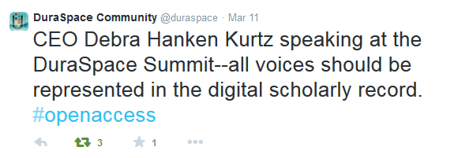
Member Summit
March 11-12, 2015 | Washington, DC
TDL a “platinum” member of DuraSpace
Representation on the DSpace Steering and Leadership Groups
DSpace Project Road Map
Ryan Steans on Working Group
DSpace use cases:
https://wiki.duraspace.org/display/DSPACE/Use+Cases
Notes:
Just last week, I attended the DuraSpace member summit, which is the annual meeting of those institutions that support the DuraSpace organization. And most of you know that DuraSpace is the umbrella organization that oversees a couple of key open source software projects that we depend on – DSpace and DuraCloud.
TDL is a platinum member of DuraSpace, supporting the DSpace project. We feel like this membership is important for a number of reasons – 1) it gives us a leadership role within the project, by allowing us seats on the DSpace Steering and Leadership Groups, which oversee the strategic direction of the DSpace project. (2) and equally important, it supports the continued development of DSpace and the health of the DuraSpace organization. We run 20 DSpace installations on behalf of our member organizations – all of us collectively have a vested in the health and sustainability of DSpace, and we want the application to continue to improve and serve the needs of our membership.
One of the fun side benefits of attending the member summit this year was getting to meet their new CEO, who we all know as our old Executive Director, Debra Hanken Kurtz. You can see in the tweet on the screen that Debra gave a state of the union address to the assembled members and led the event. She is settling in well to her new role, and we are looking forward to continuing to work closely with her and with DuraSpace.
One final word on the DuraSpace Member Summit – the two main themes of the summit, from a DSpace perspective, involve sustainability (i.e. fundraising) and the implementation of a project road map, which will guide future development of the project for the next several years.
A lot of work has been done on this road map already. The community has been collecting “use cases” from DSpace users regarding new or existing functionality that users would value. And the community is working now to synthesize those collected use cases into a cogent road map to guide development.
Our own Ryan Steans has been asked to sit on the Working Group that will support that effort. One of the big foci of the road map will be around the converging the two different user interfaces in DSpace (the JSPUI and XMLUI interfaces) into a single interface, in order to reduce inefficiencies in future development efforts. And to that end, the DSPace Community Advisory Team will be holding a meeting in April to collect more use cases focused specifically on the UI. That meeting will be April 14th at 10 AM, and when it is announced over the DSpace general list, I’ll forward it to our TDL DSpace list for those who are interested in participating.

Slide 7
Operational Updates

Slide 8
Vireo 3 release
Available on github at: https://github.com/ TexasDigitalLibrary/Vireo
Fireworks – Adeladie Skyshow 2010. By Anthony Cramp. CC BY 2.0 http://www.flickr.com/photos/ anthonycramp/ 4428561177/
Notes:
The Texas Digital Library released the latest version Vireo on GitHub during the first week of March, along with documentation for installation.
We’ve talked a lot about Vireo 3, so I won’t go into all the new features again, but this is a substantial version release with lots of new functionality and required the work of a number of people on the TDL staff and within the TDL membership, and we are thrilled to be able to release it to the open source community.
Many of you attended the Vireo 3 webinar where Ryan discussed the new features in Vireo. The recording of that event failed, and so we are re-recording the content and will have that up on the TDL website later this week.

Slide 9
Vireo Open-Source
and more…
Notes:
The Vireo open-source release means it’s available to our open-source partners, some of whom are listed here.

Slide 10
TDL-hosted Vireo
UT Austin – February 23rd
Angelo State – March 17th
UT Southwestern Medical – March 18th
University of North Texas (launched as Vireo 3)
West Texas A&M – March 19th
Texas A&M International – March 24th
Texas A&M Corpus Christi – March 25th
Texas Tech University – March 26th
Trinity University – March 27th
University of Houston – March 31st
UT Arlington – April 1st
UTMB – April 2nd
Baylor – Summer
Upgrade under way. By Ged Carrol. CC BY 2.0 http://
www.flickr.com/photos/renaissancechambara/5580788670/
Notes:
Now that the version is complete, we are also working to upgrade all of our hosted installations of Vireo over the next few weeks.
We are upgrading all hosted installations “in place,” meaning that we will not set up a clone of your installation to test. We will simply upgrade your production installation “in place.”

Slide 11
Hiring software engineer focused on DSpace development and support
Goal: By April 1
Projects may include:
Embedded media player for TDL-hosted DSpaces
Migration of UT Digital Repository to TDL
Planning upgrades to DSpace 5
Keep calm and code on, n00bs. By slworking2. http://www.flickr.com/photos/slworking/8249189090/ CC-BY-NC-SA 2.0

Slide 12
Upcoming Events
USETDA, Training, TCDL

Slide 13
Training
Introduction to DSpace Training
March 31, 2015 | University of Houston Clear Lake | More here.
ETD Management with Vireo
June 23, 2015 | University of Houston Libraries| More here.
Notes:
We do have some upcoming training opportunities.
An introductory DSpace training class will take place on March 31 at the University of Houston Clear Lake. Laura McElfresh from Texas A&M Galveston will lead that class with Faedra Wills from UT Arlington co-teaching. If you have new staff or are a new user of DSpace, or just feel like you need a refresher on DSpace version 4, this is a good opportunity.
We have also scheduled a summer-time Vireo course sponsored by the University of Houston Libraries.
All of these training sessions are free to TDL members.

Slide 14
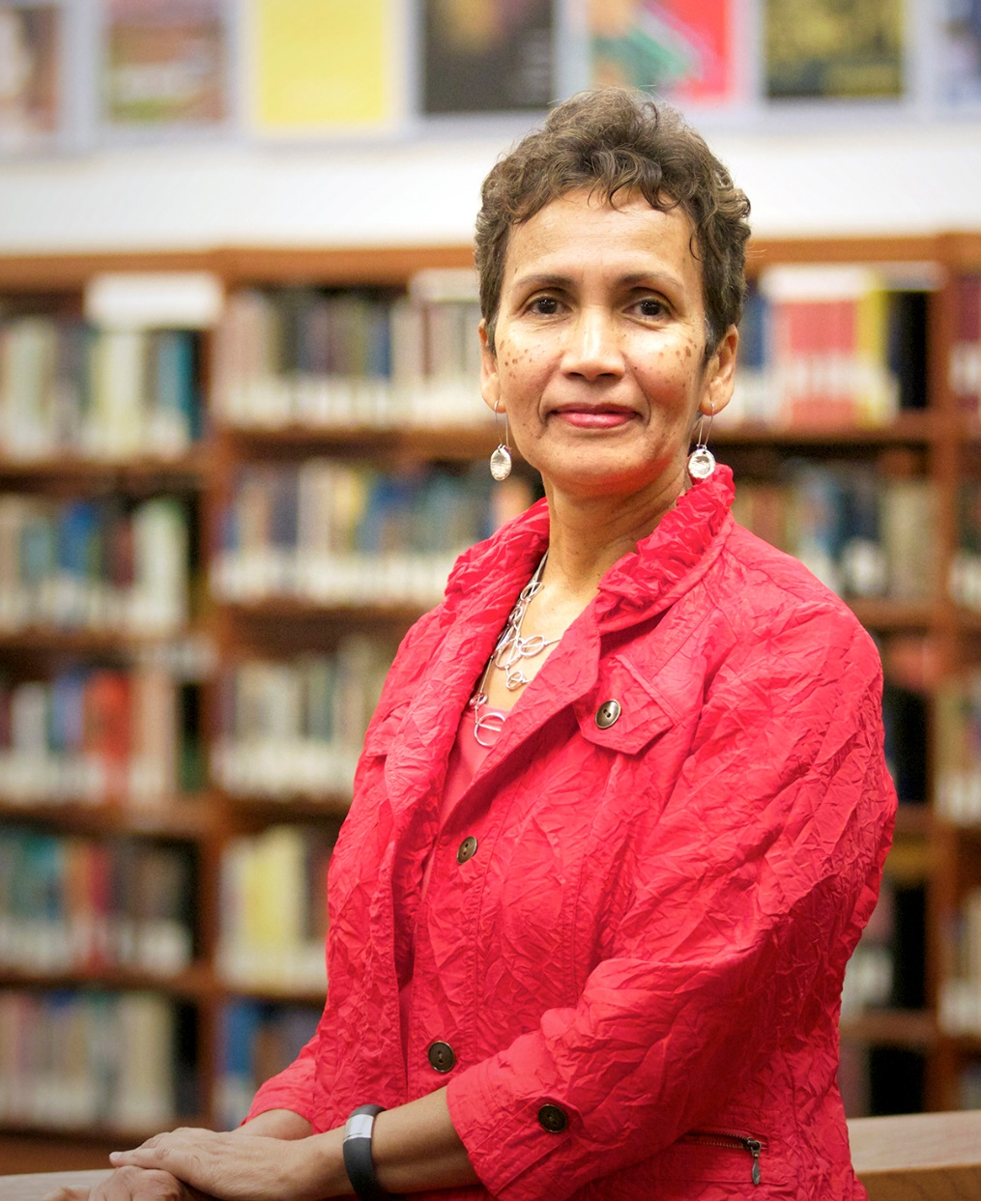
www.usetda.org
September 29-October 1 in Austin
Call for Proposals Deadline: April 15
Dr. Lorraine J. Haricombe
Vice Provost & Director of Libraries, UT Austin
Notes:
September 29-October 1 at the DoubleTree hotel in Austin
Call for Proposals Deadline: April 15
USETDA 2015 is for ETD professionals from graduate schools, libraries, academic computing and others who work with ETDs. Our goal is to offer relevant, practice-oriented content to support ETD productivity improvement, ETD professionals, advance ETD operations, and encourage the formation of state-wide ETD associations in the United States.
We are thrilled that the keynote speaker for the 2015 event will be the new vice provost and dean of libraries at UT Austin, Lorraine Haricombe.
Born and raised in South Africa, Dr. Lorraine Haricombe joined the UT Libraries as Vice Provost and Director from the Kansas University Libraries, where she has served as Dean since 2006.
Began at UT Libraries in February of this year.
In charge of implementing the Open Access policy at the university of Kansas. KU was the first public university in the USA where faculty adopted an institutional policy on open access
She has also been a leader in SPARC, the Scholarly Publications and Academic Resources Council, SPARC is an international alliance of academic and research libraries working to create a more open system of scholarly communication.

Slide 15
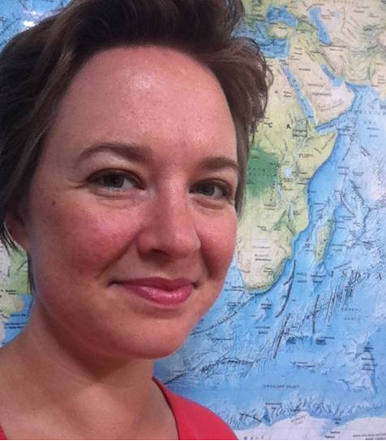
http://conferences.tdl.org/tcdl
#tcdl2015
Keynote speaker: Bess Sadler
Stanford University Libraries
@eosadler
Notes:
The Texas Conference on Digital Libraries is delighted to welcome Bess Sadler from Stanford University Libraries as the keynote speaker for 2015. Bess is Manager for Application Development at Stanford and she is an inspiring advocate for open source technology and for women in technology, and describes herself as a library “geek,” – which I think makes her a great fit for TCDL.
She helped to found several very successful open source software projects including Blacklight and Hydra, and we are really looking forward to what she will bring to the conference later this year.

Slide 16
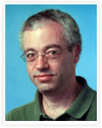
http://conferences.tdl.org/tcdl
#tcdl2015
Pre-Conference Workshop
Karma: An Open Source Tool for Linked Data
April 26, 2015 | 1-5 pm | Perry-Castañeda Library
Instructor: Dr. Pedro Szekely
http://www.isi.edu/integration/karma/
Notes:
Following on last year’s linked data workshop with Karen Coyle, the program committee has coordinated this special pre-conference workshop offering for this year’s TCDL on a data integration tool called Karma.
Karma is a tool that makes it easy to convert data from a variety of formats into Linked Data. It is free and open source and is available on github at http://github.com/usc-isi-i2/Web-Karma.
The workshop – taught by Dr. Pedro Szekely from the University of Southern California -- will introduce the basic capabilities of Karma and give attendees hands on training on Karma. There will be a small registration fee of $25 for this workshop, over and above the conference registration fee, to cover costs. You can find more about it and register for the course on the TCDL 2015 website.

Slide 17
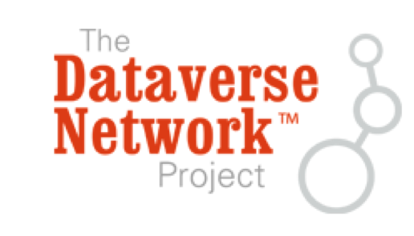
More workshops and tutorials!

Slide 18
Questions and Discussion

